Slide 1
Semiempirical Models for Depth–Dose Curves of Electrons
T. Tabata
RIAST, Osaka Pref. Univ.
Coworkers of the Project
P. Andreo,ª K. Shinoda,^{b,*}
Wang Chuanshan,^{c} Luo Wenyun^{c}
and R. Ito^{d,#}
ªIAEA
^{b}Setsunan Univ.
^{c}SARI, Shanghai Univ.
^{d}RIAST, Osaka Pref. Univ.
Present Addresses; *Non-Destructive Inspect. Co., Ltd., #Retired
Notes:
Now I would like to start a talk about semiempirical models for depth-dose curves of electrons.
Names of my coworkers on this project are given here.

Slide 2
Introduction
Classification of principal mathematical approaches to electron transport [J. C. Garth, Trans. Amer. Nucl. Soc. 52, 377 (1986)]
Monte Carlo method
Numerical solving of transport equations
Analytic and semiempirical models
Notes:
To solve the problem of electron transport through materials, there are different approaches. In his short review article, John Garth classified the methods into three categories,
First we have the Monte Carlo method;
secondly, the numerical solving of transport equations, and
thirdly, analytic and semiempirical models.
Our method belongs to this third category.

Slide 3
Quantity treated
Energy deposition D(z): absorbed dose per unit fluence at depth z
for plane-parallel beams (broad beam) normally incident on:
homogeneous semi-infinite absorbers
or multilayer slab absorbers
Equivalent to: absorbed dose per incident electron, integrated over an infinite transverse plane at depth z
for a point-monodirectional beam (narrow or pencil beam)
“Reciprocity rule”
Notes:
We consider the energy deposition D(z).
It is defined as the absorbed dose per unit fluence at depth z,
for plane-parallel electron beams normally incident on
homogeneous semi-infinite absorbers or
multilayer slab absorbers.
This definition corresponds to the experimental configuration depicted in the upper figure, and is equivalent to another definition shown below, namely the absorbed dose per incident electron, integrated over an infinite transverse plane at depth z,
for a point-monodirectional beam.
This equivalence is called “reciprocity rule.”

Slide 4
Applicability of algorithms for D(z) to beams other than broad ones
A factor in the dose-distribution expressions for beams with finite cross sections (rectangular or circular).
Abou-Mandour et al. (1983)
Central-axis depth–dose curves specific to machine conditions, by adjusting free parameters included
Notes:
The algorithm for D(z) can be applied not only for broad beams but also for narrow beams.
For example, it can serve as a factor in the dose-distribution expressions with finite cross sections.
The algorithm for D(z) can also be used to express central-axis depth–dose curves specific to machine conditions, by adjusting free parameters included.

Slide 5
Original formulation: Kobetich and Katz (1968) for semi-infinite absorbers
Expressions for η_{TN}(z) and T(z): empirical formulas
Notes:
A simple algorithm for energy deposition of electrons was first formulated by Kobetich and Katz of the University of Nebraska in 1968.
They calculated the energy deposition in semi-infinite absorbers as minus the derivative of the total residual energy of the incident electron beam, expressing the total residual energy as the product of two functions, etaTN(z) and T(z).
Here etaTN(z) is the number transmission coefficient of incident electrons for the slab absorber of thickness z, and
T(z) is the residual energy per transmitted electron.
This equation is almost nothing but the definition of the energy deposition.
Kobetich and Katz used empirical formulas for etaTN(z) and T(z).

Slide 6
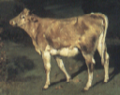
A physicist, among the specialists called in as a consultant to a dairy farm to increase its production, began: “Assume the cow is a sphere ...”
Before doing anything else, abstract out all irrelevant details. —Lawrence M. Krauss, “Fear of Physics”
Cow from Gustave Courbet, “Taureau blanc et génisse blonde” (c. 1850–51)
Notes:
The model of Kobetich and Katz is a very simple but good one, like assuming the cow to be a sphere.
The passage cited above is the well-known joke that captures the characteristic of a physicist: “A physicist, among the specialists called in as a consultant to a dairy farm to increase its production, began, ‘Assume the cow is a sphere …’”
Citing this joke, Lawrence Krauss writes in his book entitled “Fear of Physics,” “Before doing anything else, abstract out all irrelevant details.”

Slide 7
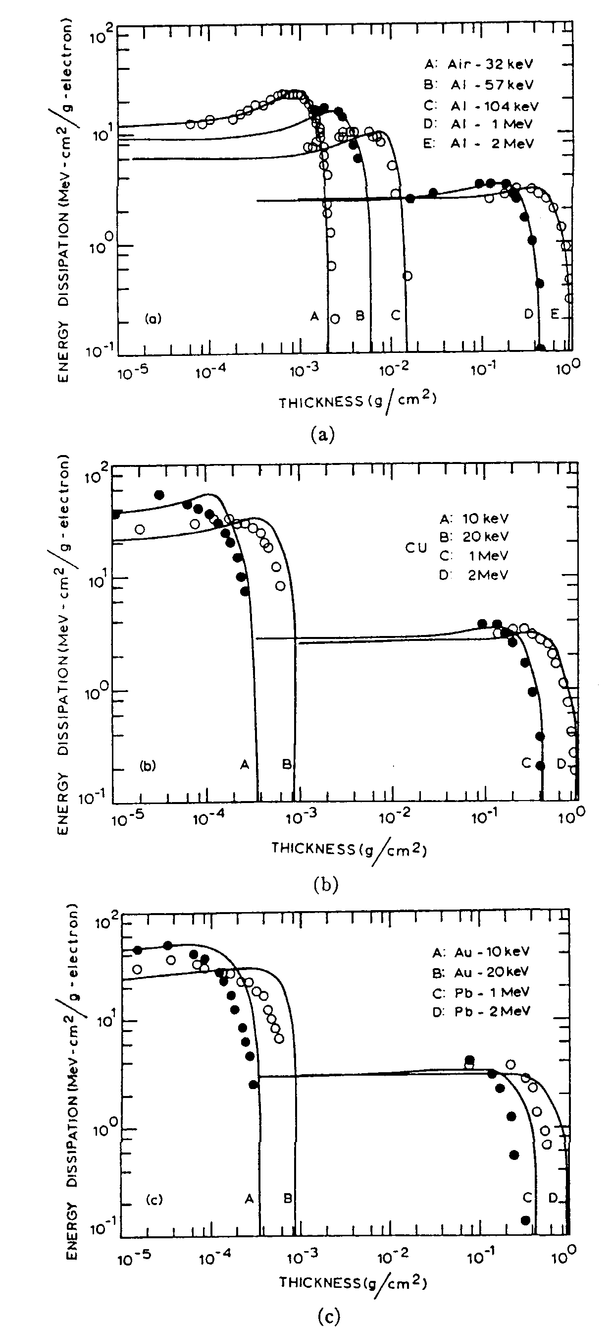
Agreement of Kobetich–Katz algorithm with experiment: Rather good when viewed on logarithmic scales
Notes:
The algorithm of Kobetich and Katz showed rather good agreement with the then available experimental data, when viewed in logarithmic scales.
Such accuracy was good enough for them, because their purpose was to obtain energy-deposition distributions caused by secondary electrons produced around the track of heavy ions.
The secondary electrons have a broad energy spectrum, so that errors might be cancelled out in the energy-deposition distributions integrated over the energy spectrum.

Slide 8
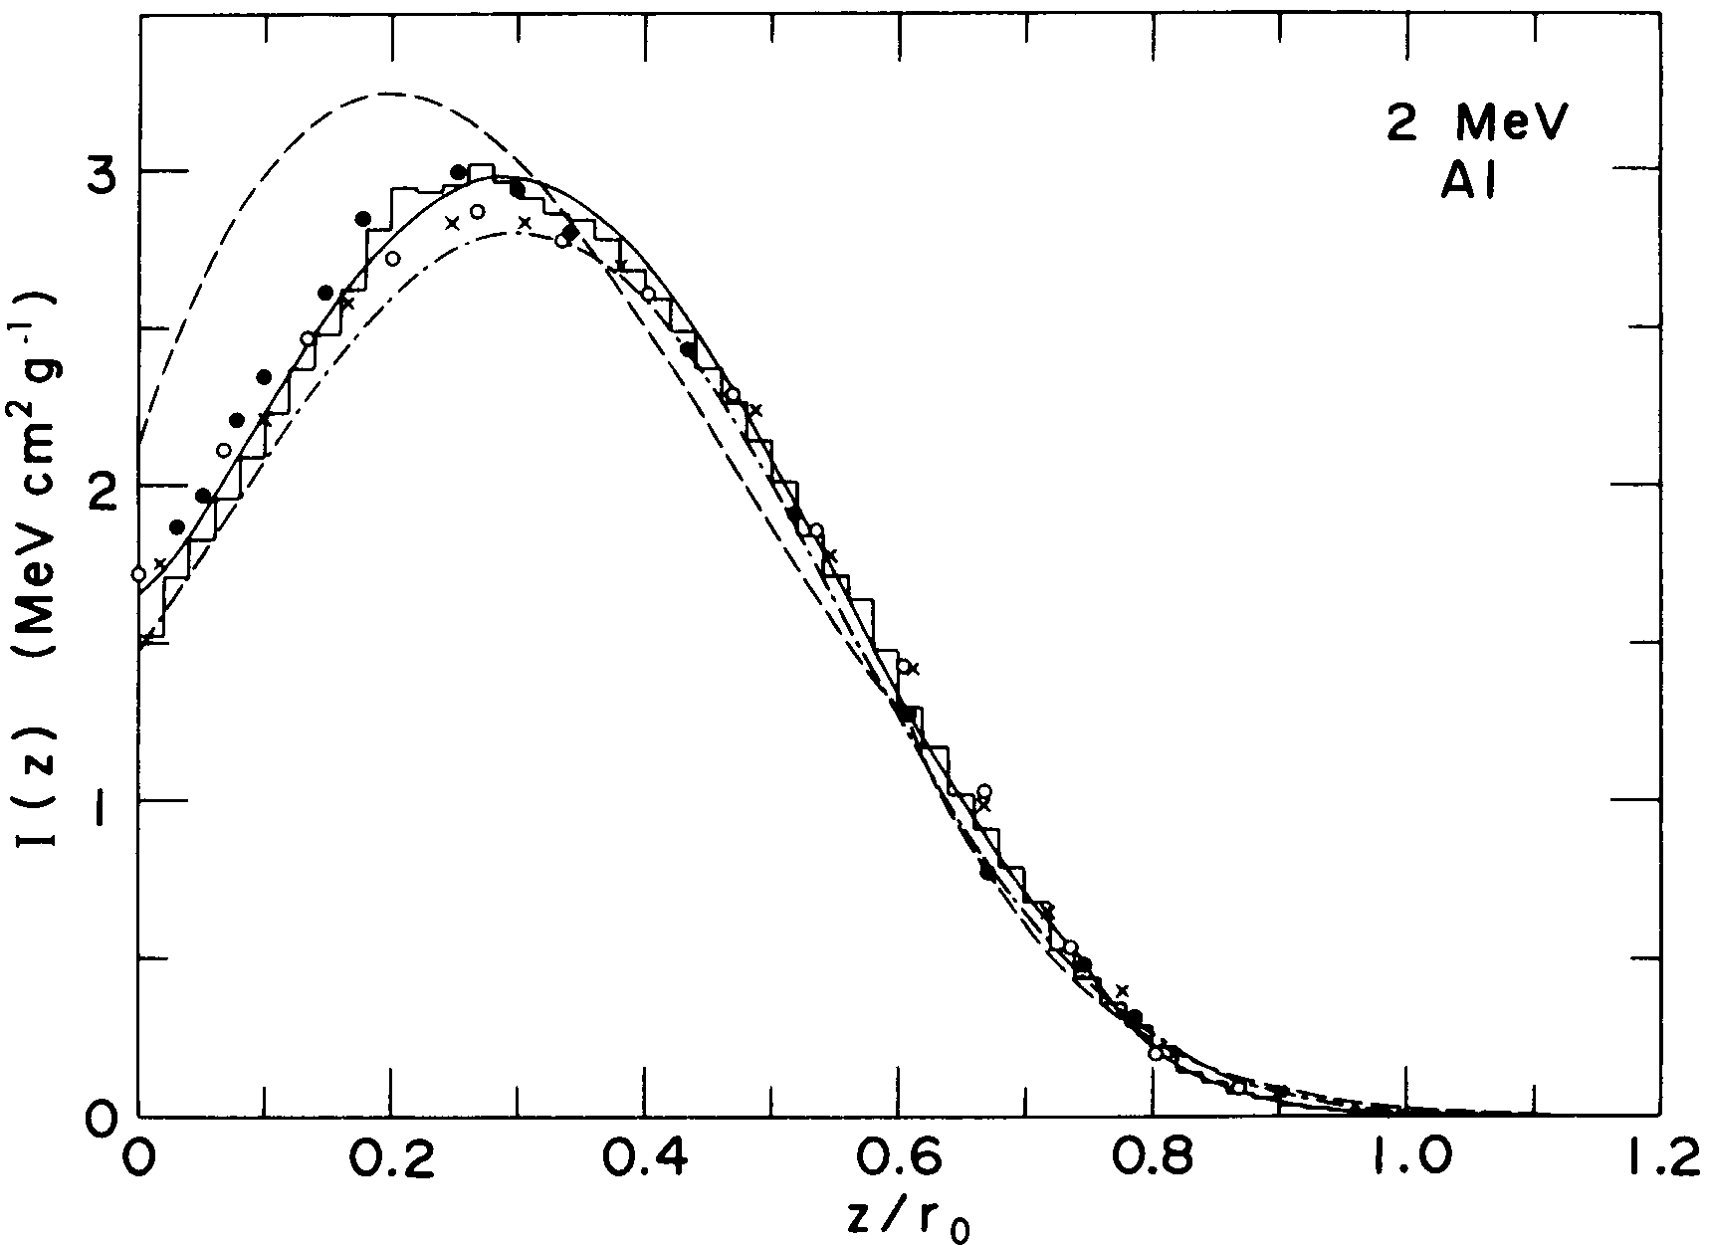
Our Work for More Accurate Algorithms
Modification of Kobetich–Katz algorithm: EDEPOS (Energy Deposition) 1974
KOBETICH & KATZ
TABATA & ITO
Notes:
However, to know the depth-dose curves of monoenergetic electron beams from accelerators, it is necessary to have more accurate algorithms. Since 1974, one of our projects has been to get more accurate algorithm for the energy deposition of electrons.
In our 1974 modification of Kobetich-Katz algorithm, we introduced a multiplication factor f to take account of the losses of energy by electrons backscattered from the incident surface and by bremsstrahlung photons penetrating deep into the absorber.
The FORTRAN code for this algorithm was named EDEPOS. It is an acronym of energy deposition.
We also used improved expressions for the functions etaTN and T. The figure in this viewgraph shows an example of improved results of our algorithm compared with that of Kobetich and Katz. The solid line represents our algorithm, and the dashed line, that of Kobetich and Katz.

Slide 9
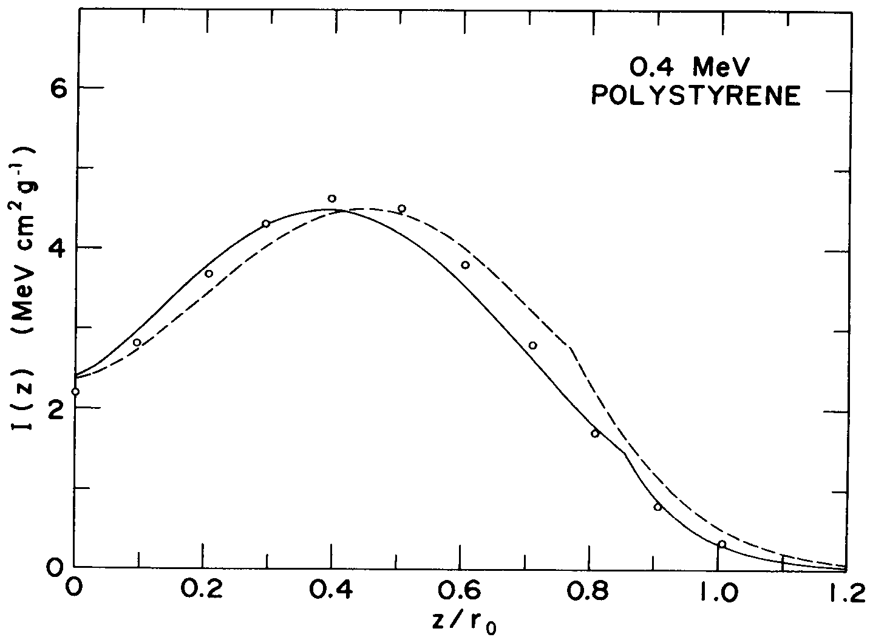
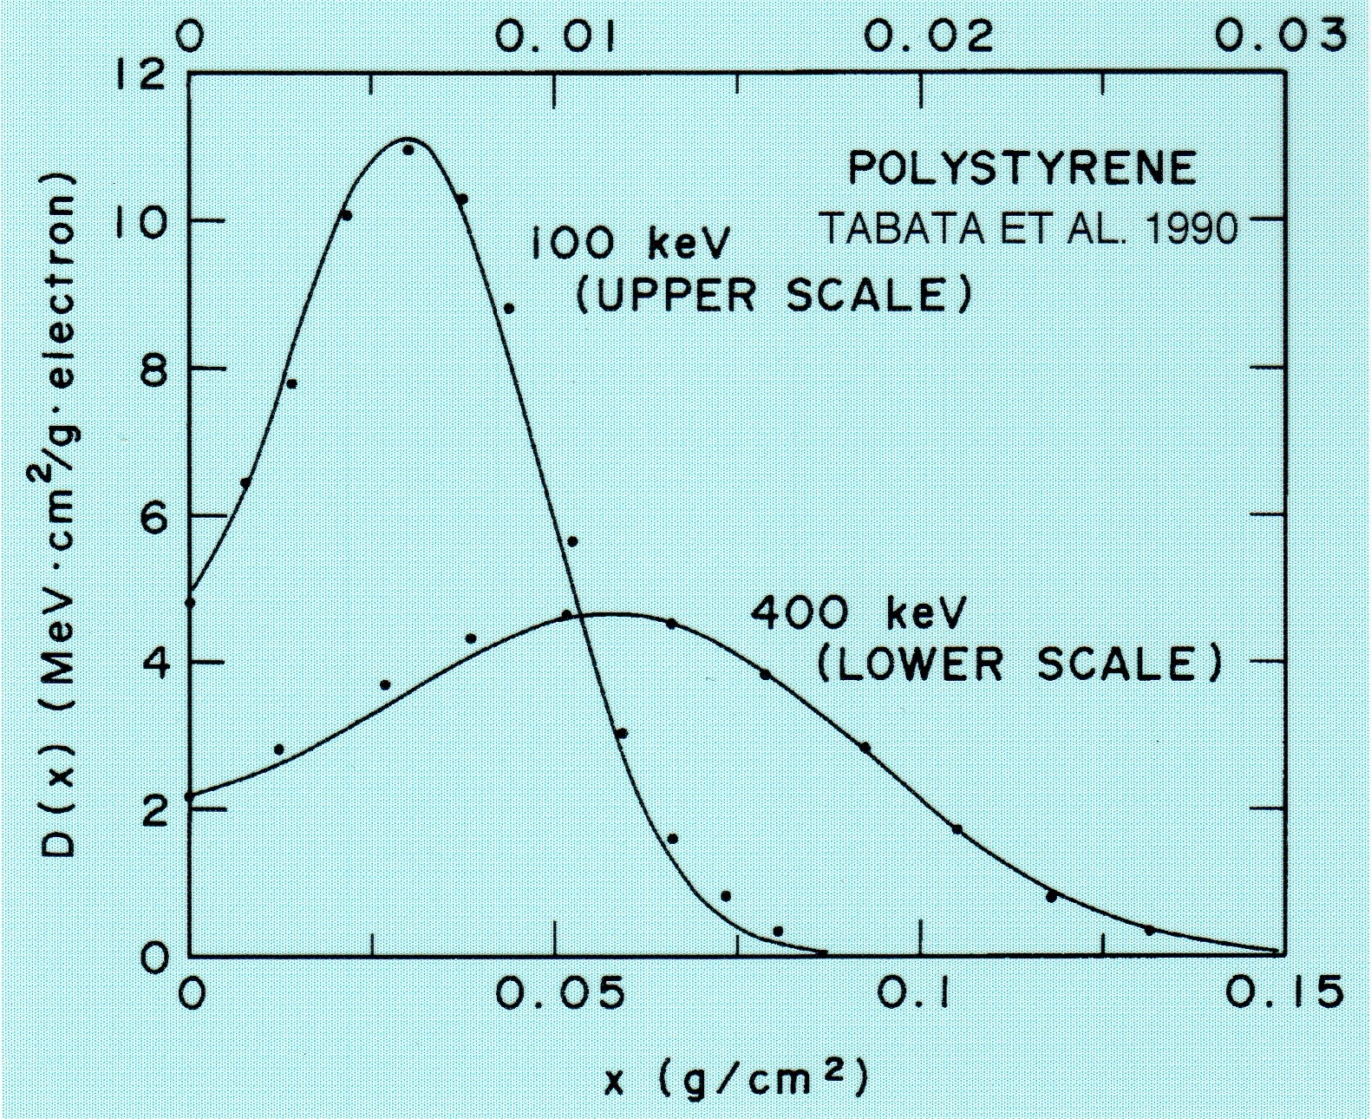
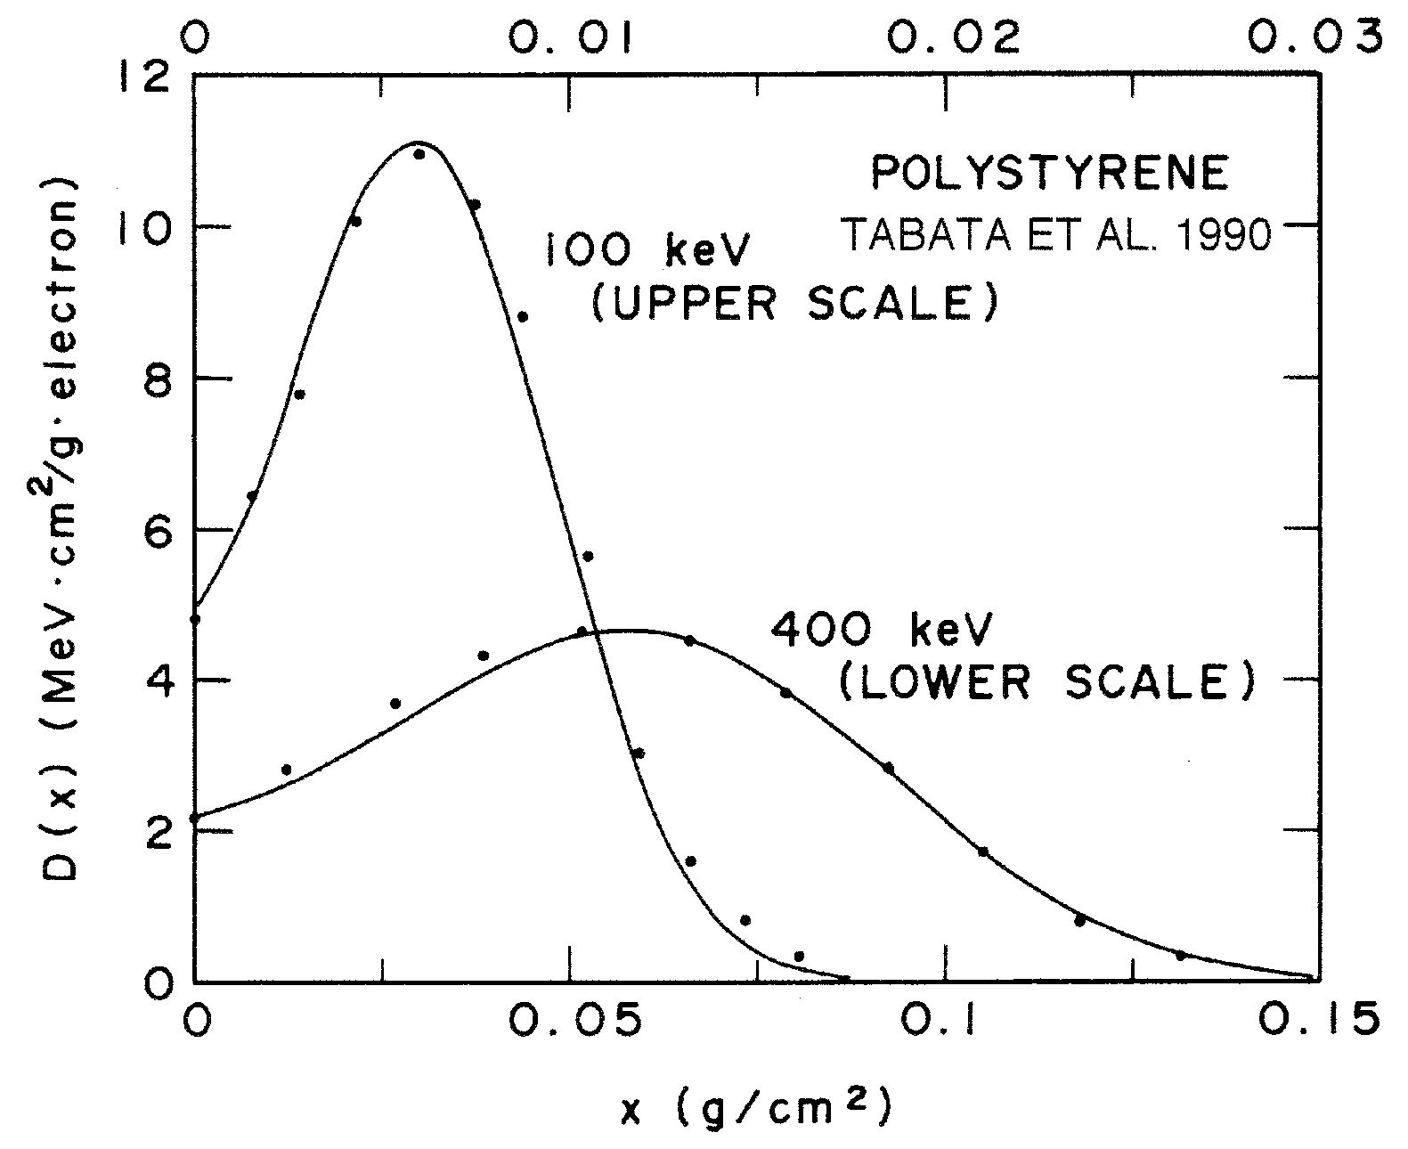
Removal of the spurious cusp caused at the joint of different functions for T(z) (for water, 1988; general, 1990)
Removal of the spurious cusp caused at the joint of different functions for T(z) (for water, 1988; general, 1990)
KOBETICH
& KATZ
KOBETICH
& KATZ
TABATA
& ITO, 1974
TABATA
& ITO, 1974
Notes:
In the results of Kobetich-Katz algorithm and ours of 1974, a spurious cusp, due to the joining of two different functions for T(z), appeared at a large depth, as can be seen at the positions indicated by arrows in the upper graph.
This defect has been removed in our 1988 and later algorithms, by the use of a single exponential function as will be shown later.
The lower graph compares the 1990 algorithm with experimental results taken from the literature.

Slide 10
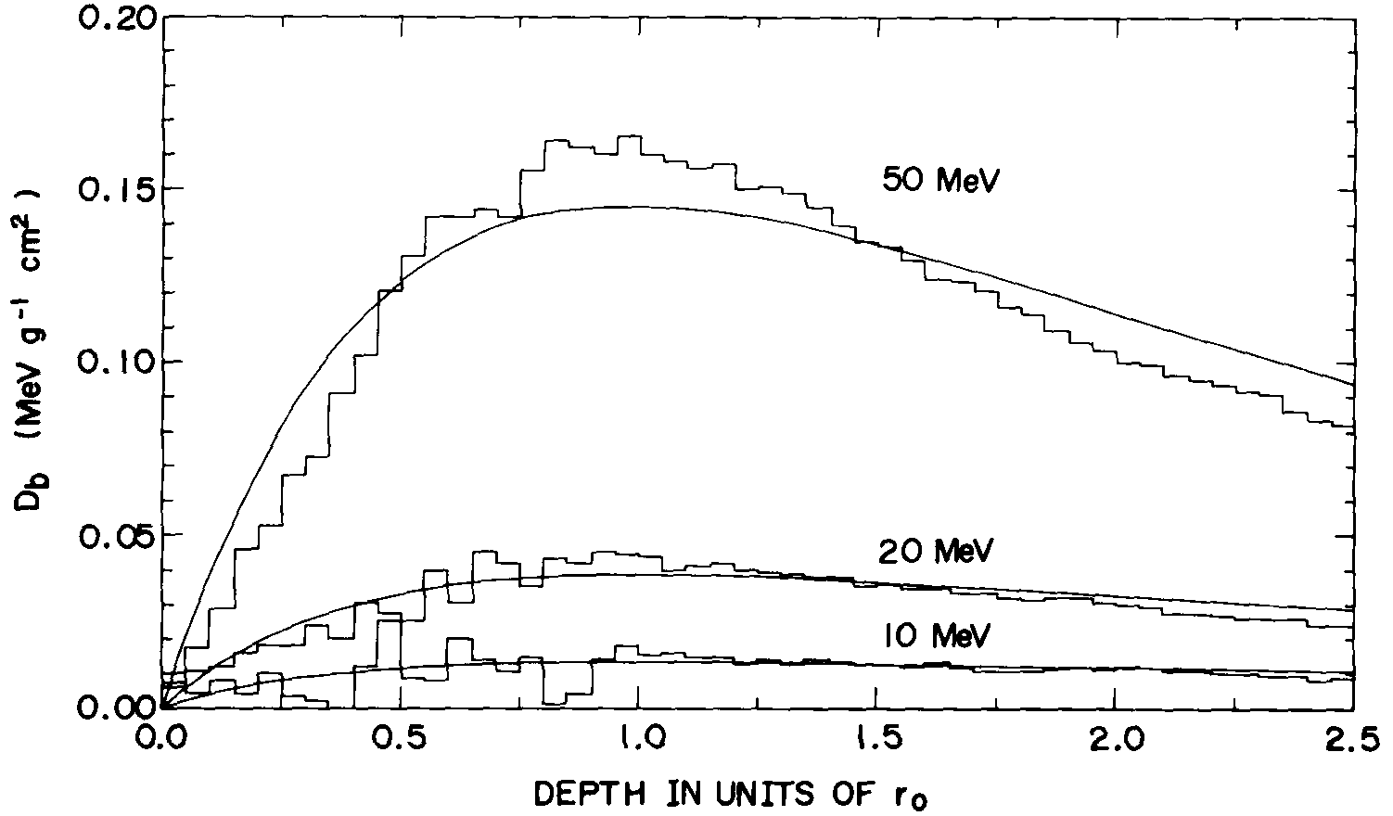
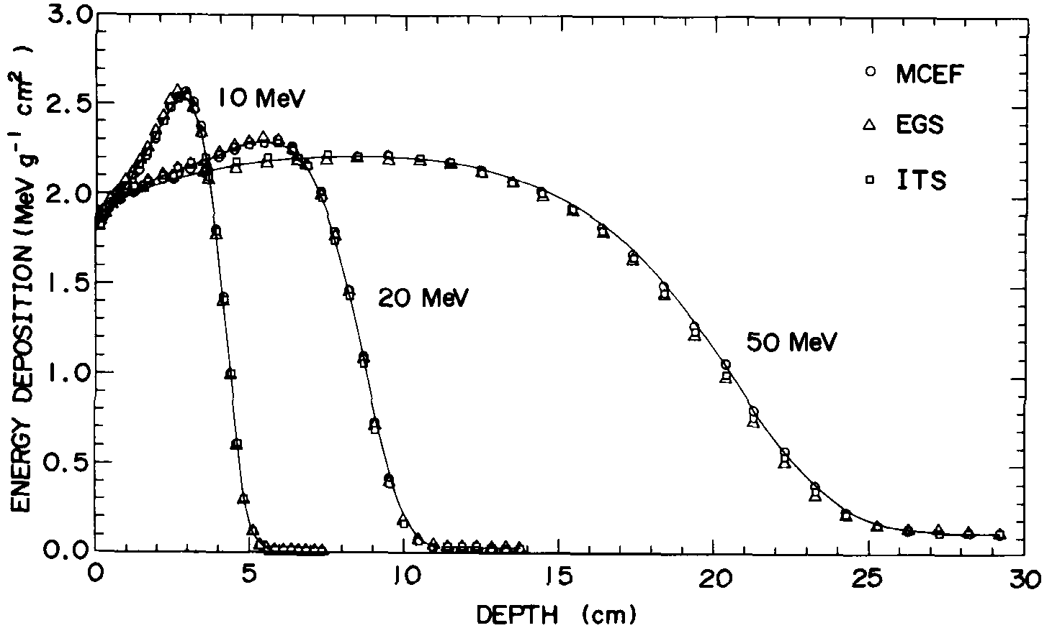
Separate expressions for collision and radiative components (1988, 1991; applicable to water only)
Bremsstrahlung component
Total energy deposition
“Assume the cow is made of two spheres ...”
Notes:
In 1988 and 1991, we published more accurate algorithms applicable only to water. These algorithms used separate expressions for collision and radiative or bremsstrahlung components of energy deposition.
The upper graph shows the comparison of our analytic expression and the Monte Carlo results for the bremsstrahlung components, and the lower graph shows the comparison for the total energy deposition.
This is an improvement like assuming that the cow is made of two spheres for the head and the body.

Slide 11
Fits to ITS Monte Carlo Results (1994–1998)
General expression for the radiative component (1994)
Notes:
Adjustable parameters in our previous algorithms for different materials were determined so as to minimize errors with respect to experimental data in the literature. However, those data did not well cover the regions of incident energy and absorber atomic number of interest.
In 1994, we started therefore a project to make a new algorithm based on the comprehensive set of Monte Carlo results obtained by the ITS system.
The ITS system is a system of Monte Carlo codes for solving the problem of coupled electron and photon transport, and was developed at Sandia National Laboratory in U. S. A.
Using the ITS results, we first developed a general expression for the radiative component of energy deposition in the form given in this viewgraph. In this equation, the depth is expressed in units of the continuous slowing-down approximation range r0, namely the path length of incident electrons in the absorber. The figure below shows the comparison of our expression with the Monte Carlo results.

Slide 12
New expressions for physical parameters
Extrapolated range together with CSDA range
Fractional energy of backscattered electrons
Photon yield by electrons
Comparison of old and new formulas for
the extrapolated range of electrons
Notes:
Next we made new expressions for the physical parameters to be used in the algorithm. The parameters considered are: the extrapolated range, the fractional energy of backscattered electrons and the photon yield by electrons.
In addition, we made new expressions for etaTN and T.
We also made an analytic formula for the CSDA range r0 for using it in the expressions for the extrapolated range and for the radiative component of energy deposition.
The figure below compares the new and old formulas for the extrapolated range with the Monte Carlo and experimental data. Solid lines show the new formula, and dashed-dotted lines show the old formula.
The vertical axis represents the ratio of the CSDA range to the extrapolated range. Improvements are most apparent in the middle energy region for the absorbers of highest atomic numbers. The present formula at energies below 10 keV is only tentative, because the CSDA range has rather large uncertainties in this energy region.

Slide 13
Fractional energy of backscattered electrons; Photon yield by electrons (1998)
Notes:
Both the fractional energy of backscattered electrons and the photon yield by electrons are used in the multiplication factor f I told you before. It is now multiplied to the collision component of energy deposition instead of total energy deposition.
This viewgraph compares the new formulas for these parameters with ITS Monte Carlo data.
In the upper figure for the fractional energy of backscattered electrons, data points at energies below 0.1 MeV are experimental data collected from the literature.
In the lower figure for the photon yield, green curves represent the radiation yield in the continuous slowing-down approximation generated by the NIST database program EPSTAR. Its definition is a little different from our Monte Carlo photon yield, but the two sets of values are very close each other except at lower energies.

Slide 14
Number transmission coefficient η_{TN}(z) and residual energy T(z)
The term a₂s² in T(z): new
Expressions for a_{i} (i=1, 2, ...5) as a function of incident energy and absorber atomic number: revised
Notes:
For the residual energy T(z) and the number transmission coefficient etaTN(z), we use the expressions as given in this viewgraph.
The term “a2 times s-squared” in T(z) is a new addition. All the expressions for the parameters a1 to a5 as a function of incident energy and absorber atomic number have been newly made or have been revised.

Slide 15
Use of tables and their interpolation:
For crucial parameters:
CSDA range
Extrapolated range
Energy-backscattering coefficient
For absorbers:
Be, C, Al, Cu, Ag, Au, U
A150, air, C552, PMMA, water, WT1
Notes:
The improvements I now described of the analytic expressions, however, were not enough to attain the precision we aimed at of the algorithm against the ITS Monte Carlo data on energy deposition.
Therefore, we finally decided to use tables and their interpolation as a function of energy
for these three crucial parameters in the algorithm.
The absorbers for which tables can be used for the last two parameters are limited to those for which we have comprehensive set of Monte Carlo data. So we provide tables of all these parameters for the absorbers
given below. Further Monte Carlo calculations can extend the table.
For absorbers other than those listed here, all the parameters are evaluated by the analytic expressions we have developed. Therefore, the precision for those absorbers would be a little worse than that for the absorbers listed here.

Slide 16
Precision attained of EDEPOS against ITS data:
Comparison of the weighted relative rms
deviations δ averaged over energies from
0.1 to 20 MeV
Notes:
We have evaluated weighted rms deviations of different versions of EDEPOS from ITS Monte Carlo data. Numbers in this table show the rms deviation delta as defined by the equations below and averaged over eight points of energies from 0.1 to 20 MeV.
The heading, “Tables,” for the second column means the algorithm in which tables are used for the three parameters mentioned before, and “Eqs.” means the algorithm in which tables are replaced by analytic expressions. The column of “Eqs.” therefore gives a measure of deviations for the absorbers for which tables are not provided.
It is to be noted that the average value of delta of the latest version with tables is 1.4%, and have been much reduced compared with the rather large average error of 8.8% of the 1990 version.

Slide 17
Application for compounds and mixtures
Mean atomic number and atomic weight for compounds and mixtures:
Notes:
To calculate the energy deposition for compounds and mixtures, we use the mean atomic number and mean atomic weight defined by the relations given in this viewgraph.

Slide 18
Comparison of the weighted relative rms
deviations δ averaged over energies from
0.1 to 20 MeV, for light compounds and
mixtures
Notes:
This table shows the deviations of the algorithm from ITS Monte Carlo data for light mixtures and compounds important in health physics.
A150 is tissue-equivalent plastic,
C552 is air-equivalent plastic, and
WT1 is a compound called “solid water”.
The value of the deviation of the algorithm with the equations is not given for air, because the analytic expressions for the CSDA range and the extrapolated range are not good for gaseous materials owing to the difference in the density effect on the stopping power. The average of the deviations for all these materials except air is 1%.

Slide 19
Examples of depth–dose curves by EDEPOS compared with ITS data (1)
Scaled depth: z/r₀
Scaled energy deposition: (r₀ /T₀ )D(z)
Notes:
This figure shows comparisons of EDEPOS with ITS data for aluminum.
The axis below-right represents incident electron energy ,
the axis below-left represents scaled depth, namely depth z over the CSDA range r₀,
and the vertical axis represents scaled energy deposition, as defined by the bottom line. T₀ denotes incident electron energy.
Red curves are EDEPOS results, and green histograms are ITS results, to which the algorithm was fitted. Precision attained of the algorithm seems to be perfect.

Slide 20
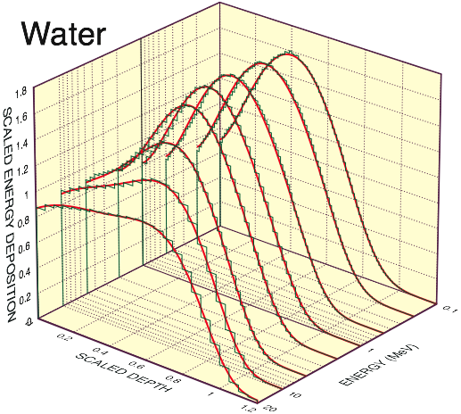
Examples of depth–dose curves by EDEPOS compared with ITS data (2)
Notes:
Here is another set of comparisons for water absorbers.
Precision is again seen to be perfect.

Slide 21
Possibility for Further Improvement of EDEPOS
Separate expression for the component due to knock-on electrons “Assume the cow is made of three spheres or more sophisticatedly three ellipsoids ...” ITS does not have standard output for the knock-on component; “KNOCK” scores: the net change in energy deposition when the knock-on processes are turned on.
Notes:
A possible method for further improvement of EDEPOS is to use a separate expression for the energy-deposition component due to knock-on electrons.
As you may guess, this is like assuming that the cow is made of three spheres, or more sophisticatedly, three ellipsoids, for the body, the head and the neck.
Unfortunately, the ITS code does not have standard output for the knock-on component of energy deposition. There are output numbers named “KNOCK,” but they give the net change in energy deposition when the knock-on processes are turned on. So it takes on both positive and negative values.

Slide 22
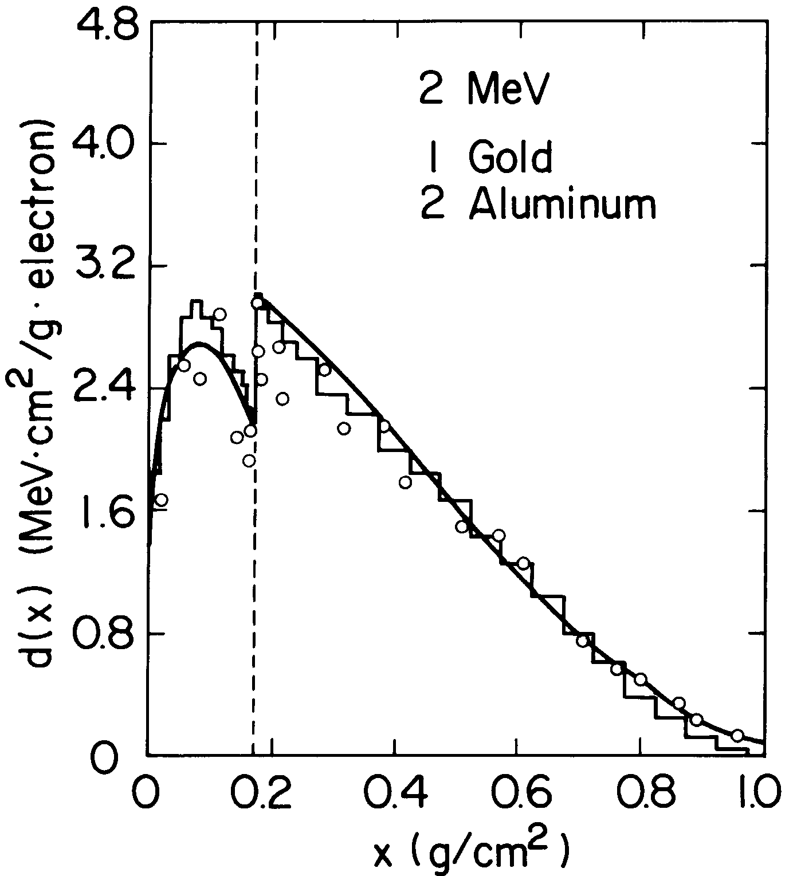
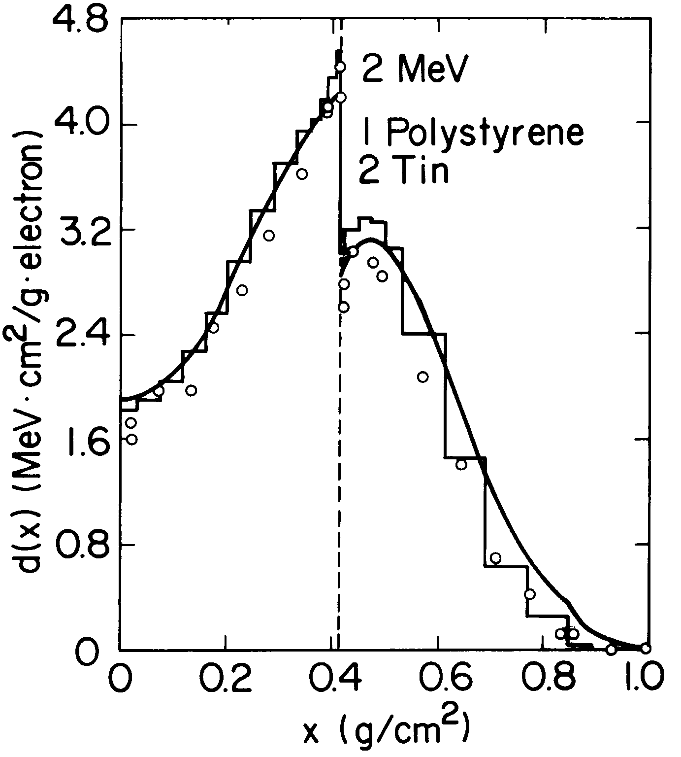
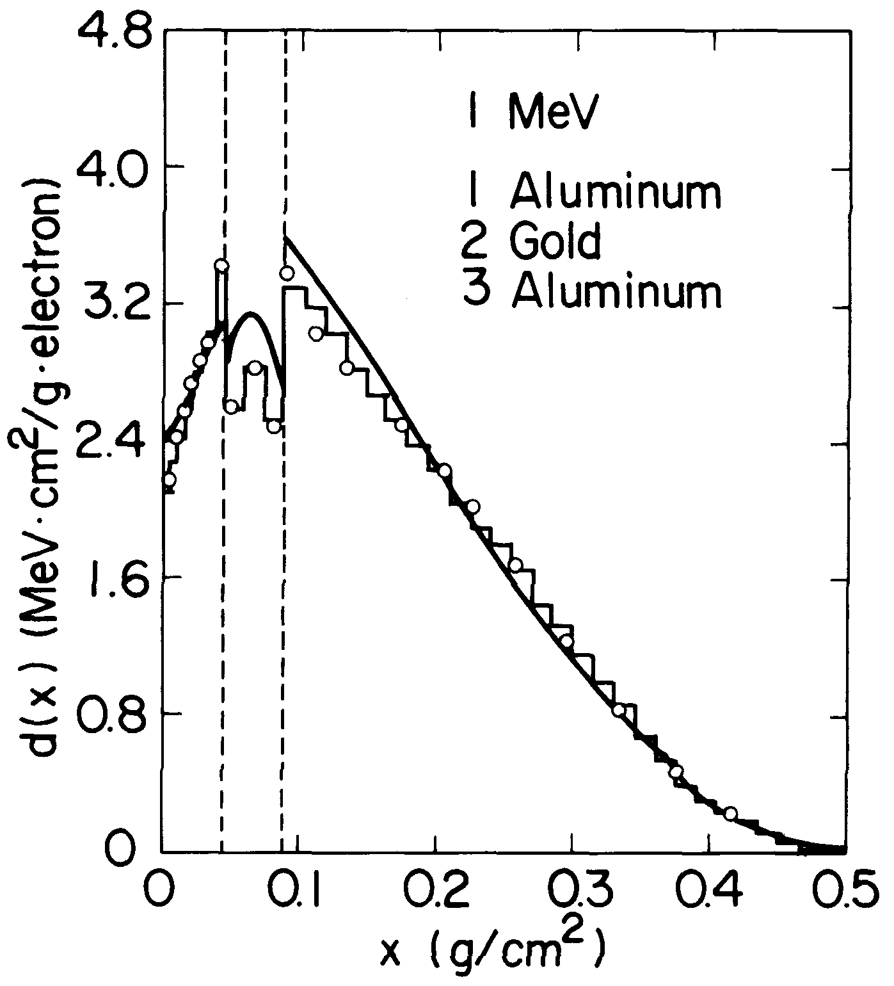
Application to Multilayer Absorbers
EDMULT (Energy Deposition in Multilayer) 1981
Modeling
Schematic paths
Equivalence rule
Notes:
Energy deposition algorithms for single semi-infinite layer can be used to evaluate energy-deposition distributions in multilayer absorbers.
We first published a multilayer algorithm in 1981. The FORTRAN code for this algorithm was named EDMULT. It is an acronym of energy deposition in multilayer.
The modeling of the multilayer algorithm is based on assuming schematic paths of electrons and an equivalence rule. These will be explained by the use of next viewgraphs.
The graphs here show some examples of comparisons of the EDMULT results with experimental and Monte Carlo results taken from the literature.

Slide 23
Schematic paths: Takes into account the effect of difference in backscattering across interfaces (at depths x_{b} and 0 in the figure below)
Solid lines, real schematic paths;
dashed lines, virtual schematic paths for correction.
Notes:
We use schematic paths as given in this viewgraph to take into account the effect of difference in backscattering across interfaces.
The difference considered for the interface at depth xb, for example, is the one between the backscattering due to material m2 in region 2 and the backscattering due to material m1 in the same region. The former is to be included in the solution, but the latter, included in the expression for the algorithm for the semi-infinite absorber, has to be subtracted.
Thus we consider in region 1, for example, virtual schematic paths for correction purposes such as s11, s13 and s14 shown by dashed lines, as well as real schematic paths such as s10 and s12 shown by solid lines.

Slide 24
Equivalence rule: Simulates two neighboring layers by a single layer
Replace the 1st layer material m₁ by the 2nd layer material m₂
Modify
the incident electron energy and
the thickness of the 1st layer so that
the residual energy and
the half-value angle of multiple scattering are kept the same at the interface
Then D(z) in the 2nd layer remains approximately unchanged
Notes:
The equivalence rule is used to simulate two neighboring layers by a single layer, for the calculation of energy-deposition distribution in the deeper layer.
For this purpose we consider, for example, to replace the 1st-layer material m1 by the 2nd-layer material m2.
In this replacement, we modify the thickness of the 1st layer and the incident electron energy so that the residual energy and the half-value angle of multiple scattering are kept the same at the interface.
Then the equivalence rule guarantees that the energy deposition distribution D(z) in the second layer remains approximately unchanged.

Slide 25
Modifications of EDMULT code
Extended to six layers (1995)
Replacement of EDEPOS included (1998)
Cause of discrepancies, now being studied
Notes:
The EDMULT code was originally applicable to absorbers consisting of up to three layers. In 1995, we have extended the code to make it applicable to absorbers consisting of up to six layers
This year we have replaced the EDEPOS code used in EDMULT by its new version.
This graph compares the EDMULT result with the result of the Monte Carlo code named PENELOPE, which was developed at the University of Barcelona.
The absorber system assumed consists of six alternating layers of aluminum and gold. The general trend of the depth dose curve is rather well predicted by EDMULT, but appreciable deviations in absolute values are seen in some of the layers. The cause of the deviations is now being studied to obtain better agreement.

Slide 26
Future of Semiempirical Models
Increasing capability of computers would favor Monte Carlo and transport-equation methods.
Semiempirical models together with various analytic formulas for physical parameters would however continue to be used for:
simple and rapid evaluation
inclusion in a large computer programs in which electron penetration is one of many relevant phenomena.
Notes:
Before concluding, I would like to say a word about the future of semiempirical models.
Increasing capabilities of computers would favor Monte Carlo and transport-equation methods in solving the transport problem of electrons.
Semiempirical models together with various analytic formulas for physical parameters would however continue to be useful for
simple and rapid evaluation, for example, in the preliminary study of the optimum irradiation condition, and
inclusion in a large computer programs, in which electron penetration is one of many relevant phenomena.

Slide 27
Conclusion
Physicists always prefer a simple description of a phenomenon to a full and exhaustive one, even at the price of having to make later corrections ...
Roger G. Newton, “What
Makes Nature Tick?”
This proves that we are physicists.
Notes:
In the book entitled “What Makes Nature Tick?” written by Roger Newton, I found this passage:
“Physicists always prefer a simple description of a phenomenon to a full and exhaustive one, even at the price of having to make later corrections ...”
This is just what we have been doing about semiempirical models for the energy deposition of electrons. Therefore, this passage proves that we are physicists.
Thank you very much for your attention, and thank you, Professor Jia, for nice interpretation.

